Slide 1


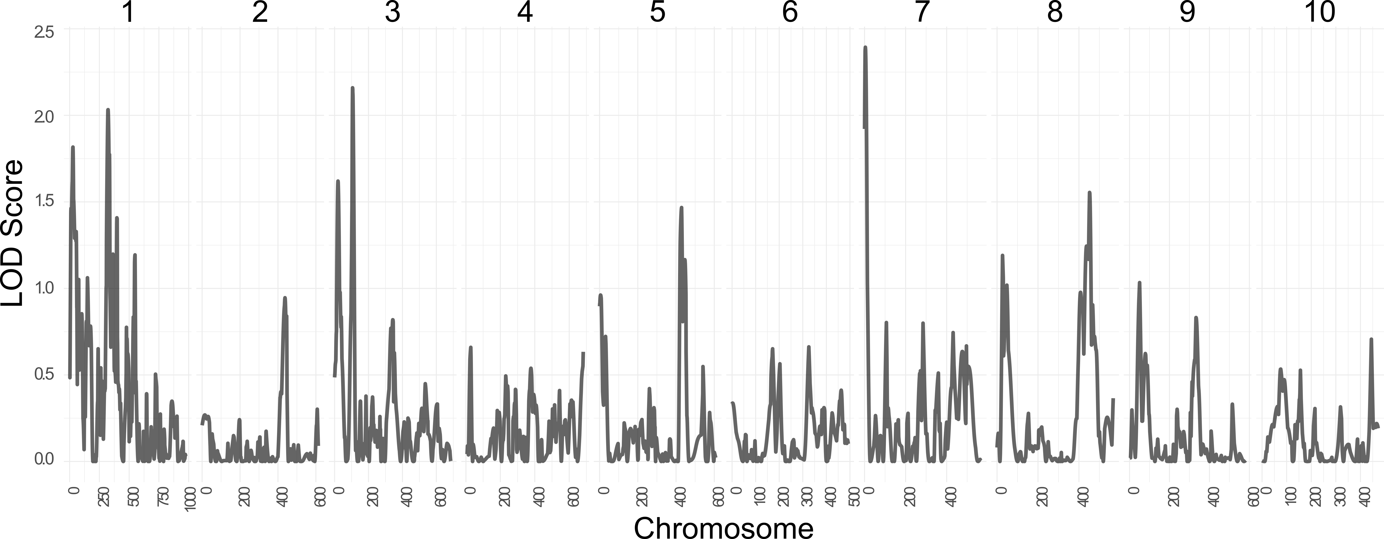
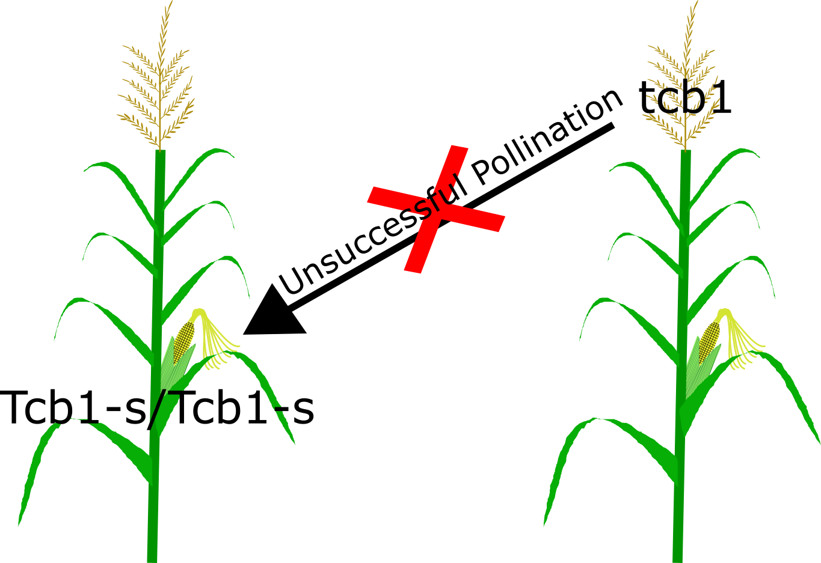
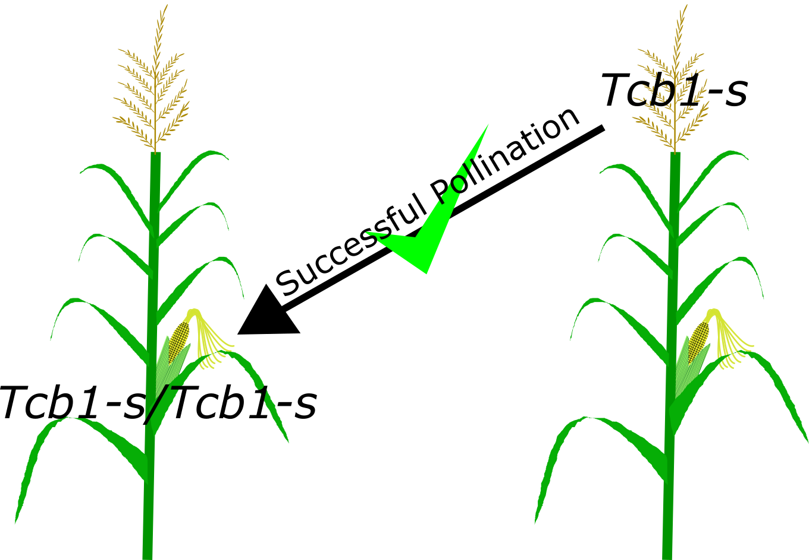
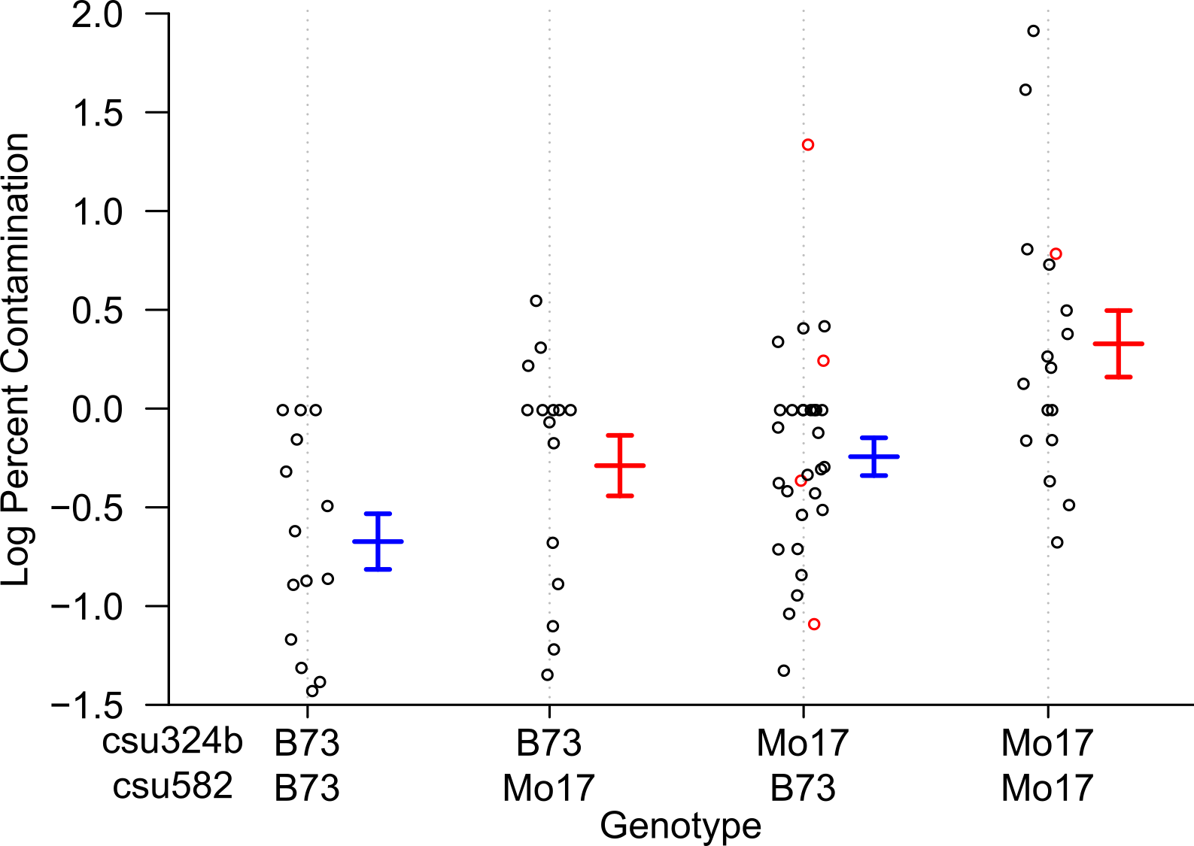
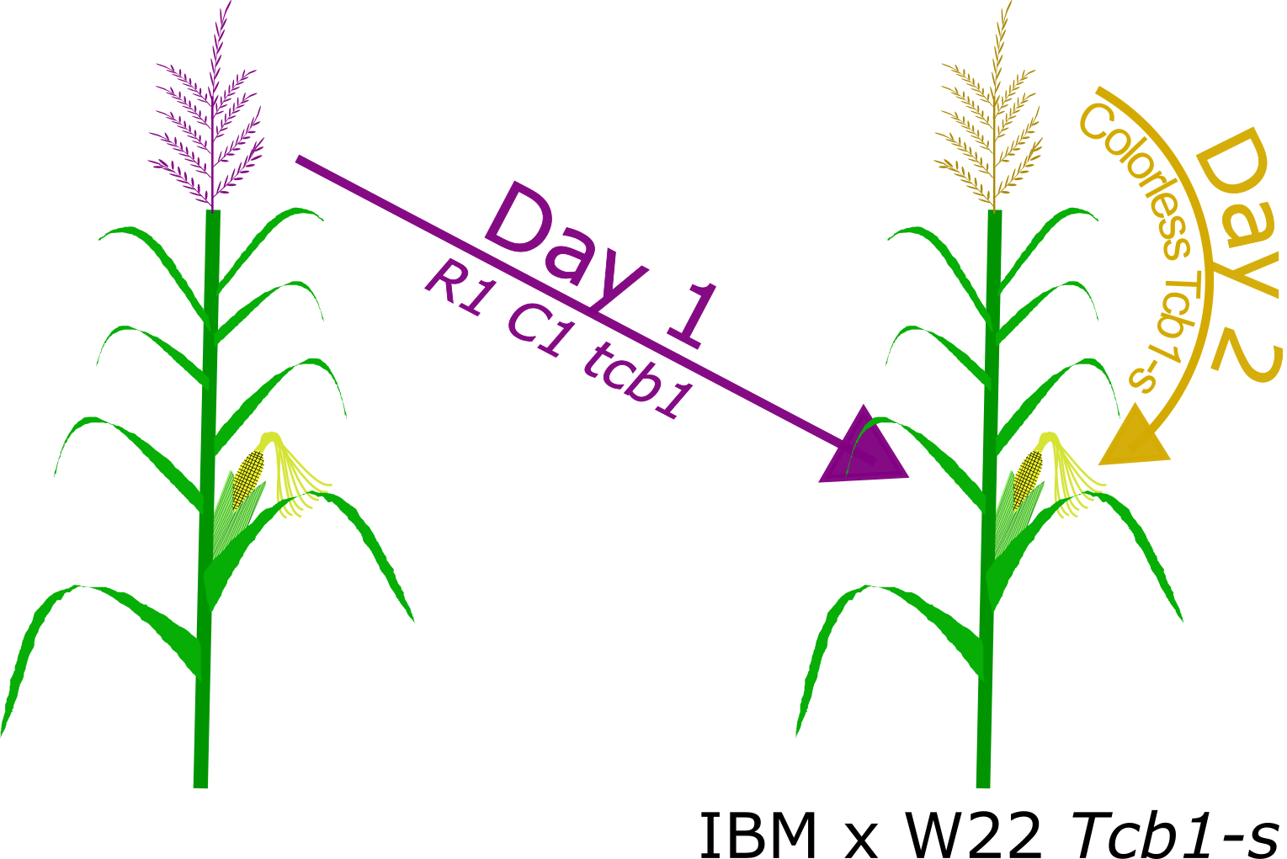
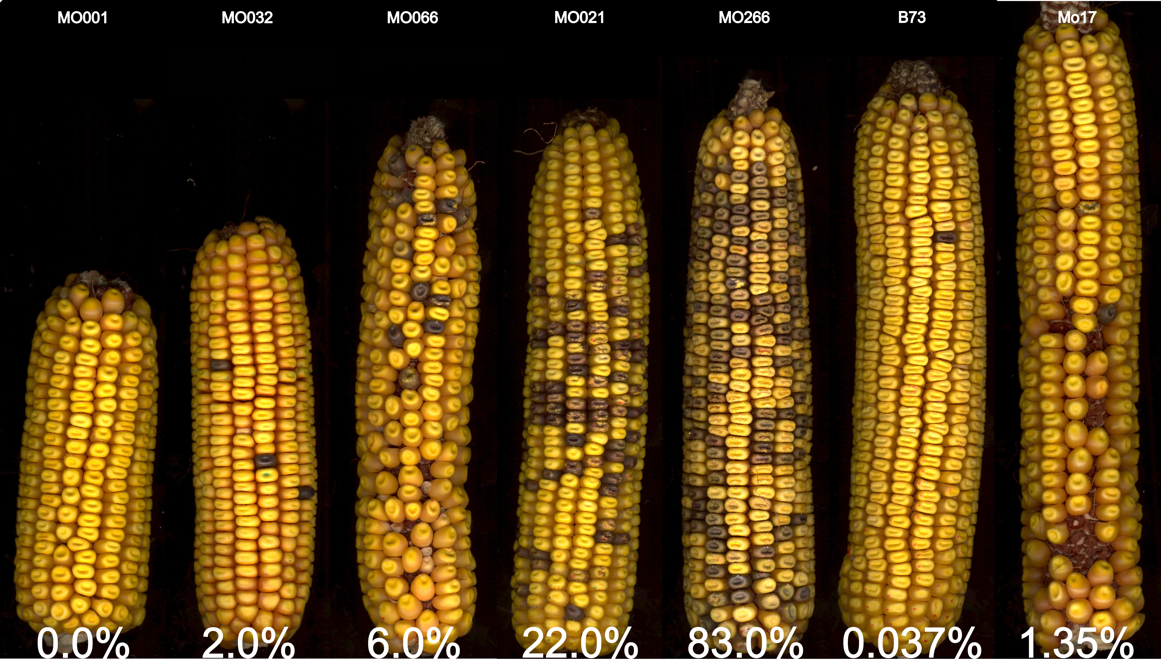


Mapping Loci that Modify the Efficacy of Teosinte crossing barrier 1
Merritt B. Burch and Donald Auger
Department of Biology and Microbiology, South Dakota State University, Brookings SD 57007, USA
Introduction & Background
Windborne contamination of organic or specialty maize by genetically modified pollen can decrease profits. Currently, farmers place barrier crops, separate fields, or displace planting times to prevent cross contamination.
An alternative is to use Teosinte crossing barrier 1 (Tcb1), a maize gametophyte cross incompatibility system.
Tcb1 was found in teosinte (Z. mays spp. Mexicana) and blocks fertilization by pollen with incompatible alleles (tcb1) (Fig 1).
F1s of most maize inbreds (e.g. B73) x W22 Tcb1-s (strong allele) show high incompatibility with tcb1; F1s of Mo17 x W22 Tcb1-s shows a weakened incompatibility (Jerry Kermicle, personal correspondence).
Results
A
B
Fig 4: QTL map for modifiers that affect Tcb1-s efficacy. Facets indicate separate chromosomes. The recombination fraction for each marker position is shown on the x-axis. Eight QTL peaks on chromosome 1, 3, 5, 7, and 8 exceed a LOD threshold of 1.5 and explained 49% of the phenotypic variability.
Eight QTL were detected that contribute to Tcb1-s efficacy and explained 49% of the phenotypic variability (LOD = 11.22, p_{8,76}=1.21e-07, n = 77).
Of the eight QTL, only four showed strong evidence based on QTL estimates and their SE, confidence intervals, 2-way QTL scans, and multi-QTL scans.
Some evidence for a pair of interacting QTL on chr. 4 (locations of tcb1 and ga1), however, the lack of strong QTL peaks in Fig. 4 makes this unlikely.
QTLs on chr. 3, 5, and 7 show additive effects where the B73 allele contributes more towards Tcb1 efficacy than Mo17. Vice versa for the QTL on chr. 8.
Genes underlying the strongest QTLs on chr. 3 and 7 contain 2-component sensor kinases, wrky transcription factors, PPR-repeat containing proteins, pyridoxin biosynthesis proteins, and lysine degradation enzymes.
Table 1: Estimated QTL effects for the four most reliable Tcb1 QTL and their underlying markers. The chromosomal location, estimated effect, SE, nearest marker, region size, and the number of underlying candidate genes within that marker region is shown.
Fig 1: Teosinte crossing barrier 1 (Tcb1) cross incompatibility. A: Unsuccessful pollination between Tcb1-s silks and tcb1 pollen.
B: Successful pollination between Tcb1-s silks and Tcb1-s pollen.
Loci | Est. | SE | Nearest Marker | Region Size | No. Genes
3@106 | 0.201 | 0.069 | csu324b | 389 Kb | 23
5@429 | 0.166 | 0.068 | bnlg609 | 1.1 Mb | 41
7@4 | 0.222 | 0.064 | csu582 | 1.4 Kb | 1
8@452 | -0.129 | 0.067 | umc1268 | 389 Kb | 19
Objectives
Find QTL for Tcb1 modifying loci using the intermated B73-Mo17 (IBM94) population
Identifying QTL regions is the first step toward isolating candidate genes, with the ultimate goal to determine the molecular mechanism(s) for Tcb1 cross incompatibility
Materials and Methods
Mooo
Fig 2: Test of IBM/W22 Tcb1-s efficacy. Pollination of Tcb1-s silks with colored R1 C1 tcb1 pollen on day one and self-pollination on day two with r1 c1 pollen (n = 5).
Fig. 5: Effect plot of B73 and Mo17 allelic combinations at the chromosome 3 and 7 QTL. The QTL at chromosome 3 (csu324b) and 7 (csu582) show evidence for a coupling effect, with the strongest Tcb1 efficacy when homozygous B73 at these two loci.
MO001/W22 MO032/W22 MO066/W22 MO021/W22 MO266/W22 B73/W22 Mo17/W2
Discussion & Conclusions
Eight QTLs, but only four showing consistent support, are involved in modifying Tcb1 efficacy in the IBM 94 population.
The eight QTL model explains 49% of the phenotypic variability. Our data do not reliably detect any QTL on chr. 4, the location of tcb1.
Three detected QTL show that the B73 allele contributes more than the Mo17 allele toward Tcb1 efficacy.
Alternatively, in the chr. 8 QTL it is the Mo17 allele that provides strong Tcb1 efficacy.
The four QTL cover a large genetic range spanning roughly 90 protein coding genes.
Some of the most notable, and having a potentially large effect, are various transcription factors and proteins involved in signaling cascades.
Future Directions
Retest the eight most interesting QTL to confirm results.
Redo this experiment using the larger, IBM302 population. The lack of QTL detected on chr. 4 may be do to a reduced marker density in the IBM94 population.
Preform RNAseq, similar to Lauter et al. (2017) with Ga1-s to see if a similar ZmPme3 mechanism is expressed in Tcb1-s silks
Fig 3: Range of ear phenotypes resulting from Fig 2 crosses. From left to right: strong to weak effect of IBM x W22 Tcb1-s silks rejecting colored tcb1 pollen. The two ears to far right are B73/Tcb1-s and Mo17/Tcb1-s controls.
F1’s between IBM RILs x Tcb1-s W22 were generated in 2016 and tested in 2017 in Brookings, South Dakota (n = 5).
The QTL map was generated by associating the log transformed mean percent contamination of each RIL with the IBM-94 map using R/qtl using 10,000 permutations.
One-way, two-way, and multi-QTL models were tested on the Tcb1 data.
Acknowledgments
This project was supported by NSF-PGR grant number 1340050 through the Carnegie Research Institution. We also acknowledge support from SDSU-AES.

